Slide 1
Immunodeficiency diseases
Dr. wasan Abd Alameer 2017

Slide 2
Objectives
Defintion and classification of immunodeficiency diseases.
Types of primary immunedeficiency diseases.
Identify the most common immune deficiency disorders

Slide 3
Immunodeficiency diseases
Inadequate Immune Responses to Infectious Agents.
Primary (inherited) or secondary (acquired).
Clinically, recurrent infections or opportunistic infections.
Recurrent infections with pyogenic bacteria (staphylococci) indicate a B-cell deficiency ,whereas recurrent infections with certain fungi, viruses, or protozoa indicate a T-cell deficiency.

Slide 4
Immunodeficency dis.
Primary
secondary
Humeral
Cellular
Combined
Complement
Phagocytes

Slide 5
Primary (congenital) immunodeficiency disease
Humeral (B- cell deficiencies)
Infantile agamma globulinaemia (Bruton’s syndrome);
pure B cell deficiency syndrome,
X- linked due to lack of tyrosine kinase which results in failure of B cell development and few or absent B cell count with low immunoglobulin levels .
patient presented with repeated pyogenic infection .

Slide 7
2. Common variable immunodeficiency (acquired”hypogammaglobulinemia).
This includes a large number of cases of primary immunodeficiency, heterogeneous in presentation, with variable age of onset and patterns of inheritance, whose clinical picture is similar to X-linked agammaglobulinemia, but usually with a less severe course.

Slide 8
3. Ig A deficiency
The most common immunodeficiency.
Very low IgA level with normal B cell count
Failure of heavy chain gene switching
Most patients with IgA deficiency are asymptomatic
Some have recurrent infections, especially of the sinuses and lung, caused by pyogenic bacteria
Anti-IgA antibodies can be detected in about one-third of the patients, and hypersensitivity reactions (which may be fatal) upon transfusion of gamma globulin preparations).

Slide 9
4. Hyper IgM syndrome.
This syndrome is characterized by low levels of IgG, IgA, and IgD in association to a marked elevation of IgM.

Slide 10
Cellular immunodeficiency
Thymic aplasia (Digeorge syndrome)
Deletion of 22q11 causing defective development of pharyngeal pouches .
Thymus and the parathyroids fail to develop properly.
The main clinical presentation include neonatal tetany (due to hypocalcaemia caused by hypoparathyroidism), abnormalities of the heart and the large vessles , facial dysmorphism, mental subnormality and frequent infection episodes .
Absence of T cells while B cells have normal count but defective function,

Slide 11
2. Chronic mucocutaneous candidiasis.
The skin and mucous membranes of children are infected with Candida albicans .
T- cell deficiency specifically for this organism.
Other T-cell and B-cell functions are normal.

Slide 12
Combined immunodeficiency
Severe combined immunodeficiency disease (SCID)
Deficiency of both B-cell and T-cell function.
Recurrent infections with bacteria, viruses, fungi and protozoa occurs in early infancy (3 months).
It is inherited disease due to defect in differentiation of an early stem cell.

Slide 13
There are two types of SCID inheritance ; the X- linked disease characterize by defect in gamma chain of interleukin 2.
The autosomal SCID type is due to a defect in the Adenosine deaminase (ADA) or purine nucleoside phosphorylase (PNP) gene which results in accumulation of d ATP, d GTP which are toxic to the lymphoid stem cells.

Slide 14
Combined immunodeficiency
Wiskott-Aldrich syndrome (Immunodeficiency with thrombocytopenia and eczema)
It is a genetically transmitted disease, with a X-linked recessive pattern of inheritance
Cell mediated immune reaction are absent and antibody responses are defective.
Mutation in WAS gene coding for actin protein which is critical in maintain cytoskeleton structure.
Clinically, characterized by eczema, bleeding, and frequent infections.

Slide 15
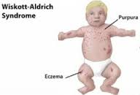

Slide 16
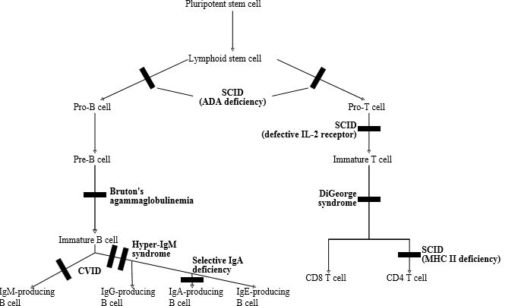

Slide 17
D. Complement Deficiencies
Early complement C1-C4 deficiency results in infection with encapsulated bacteria.
C3 deficiency
Susceptible to sepsis with pyogenic bacteria such as staphylococcus aureus.
C6,C7 or C8 especially prone to bacteremia with Neisseria .

Slide 18
Hereditary angioedema
Autosomal dominant disease caused by C1 inhibitors deficiency.
C1 continue to act on C4 to generate C4a and subsequent C3a,C5a vasoactive components.
Laryngeal oedema can be fatal.

Slide 19
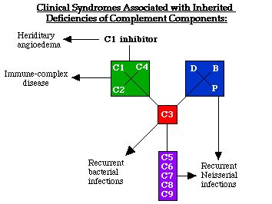

Slide 20
Phagocyte deficiencies
Chronic Granulomatous Disease
Defective bactericidal activity of the monocytes and neutrophils because no oxidative burst.
Deficient NADPH oxidase activity.
Clinically, pyogenic infections, especially with catalase positive staphlococcus aureus and Aspergillus.
B- cells and T-cells are normal .

Slide 21
Secondary immune deficiency
These disorders generally develop later in life.
They are more common than primary immunodeficiency disorders.

Slide 22
Immunodeficiency caused by drugs
Drugs causing neutropinea , when neutrophil count <500ul , it predispose to severe infections caused by pyogenic bacteria and enteric gram negative rods.
Cytotoxic drugs in cancer chemotherapy;
Immunosuppressive drugs in autoimmune disease;
Corticosteroids

Slide 23
Infection
HIV which alters T cell immunity and allows further infection with opportunistic pathogens.
certain bacteria release toxins that function as superantigens, initially stimulating large numbers of T cells to proliferate but, because of the release of cytokines from T cells, ultimately suppressing the immune response and allowing the pathogen to multiply.

Slide 24
Other causes
Renal failure
Diabetes
Mal nutrition
Liver Failure

Slide 25
Thanks

